Slide 1
Welcome to Eastview!
Guidance Team 2023-2024

Slide 2
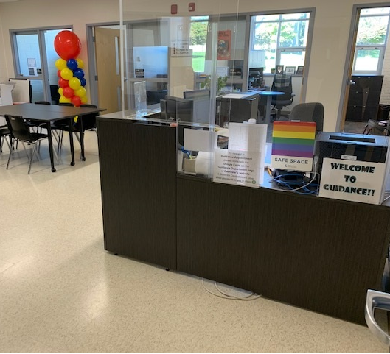
This is our Guidance Office at Eastview, located in Room 137 beside the main office.
Let’s meet our team…

Slide 3
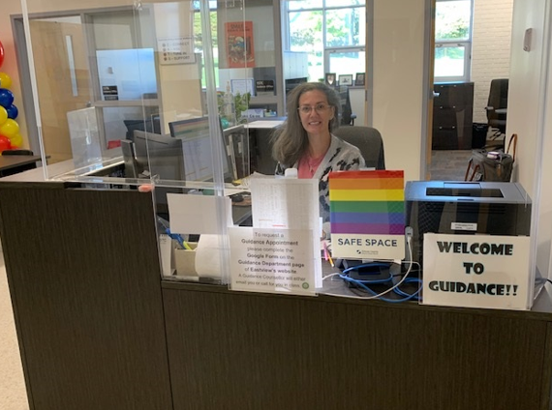
Mrs. Hart:
Guidance Secretary
thart@scdsb.on.ca

Slide 4
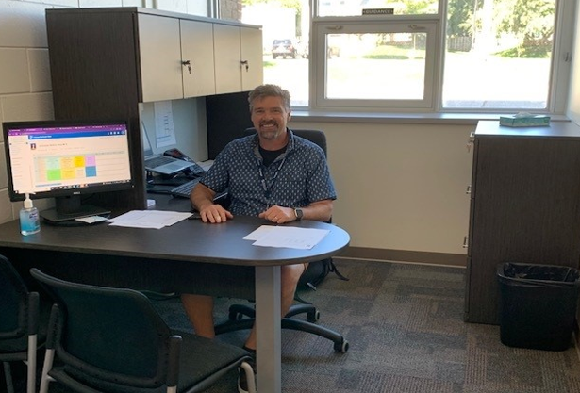
Mr. Wilson:
Guidance Counsellor for surnames A-C
tawilson@scdsb.on.ca

Slide 5
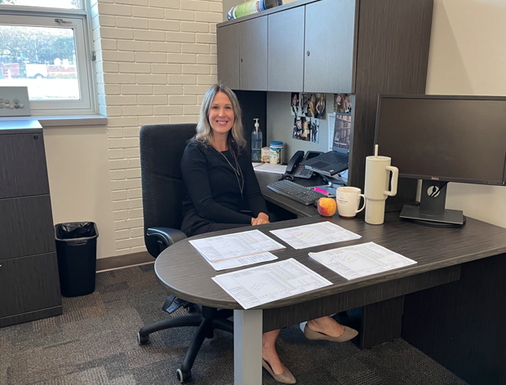
Mrs. Crawford:
Guidance Counsellor for surnames D-K
lecrawford@scdsb.on.ca

Slide 6
Ms. Glass:
Guidance Counsellor for surnames L-Q
lglass@scdsb.on.ca

Slide 7
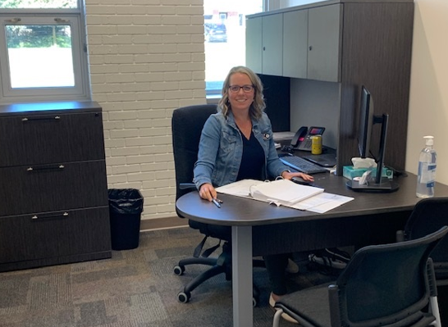
Mrs. Paemurd:
Guidance Counsellor for surnames
R-Z
rpaemurd@scdsb.on.ca

Slide 8
WHY MIGHT YOU BOOK AN APPOINTMENT WITH GUIDANCE?
Course planning and course selection - not sure what a course is? Come ask…
Planning and research for post-secondary - not sure what you need to apply? Let's check together.
College and university scholarship application process - don't panic!
Decision-making, problem-solving, conflict resolution & study skills - We can help…
Stress and time management; relationship awareness; concerns about addiction or mental health - for you or someone else - high school can be hard! Let us help!

Slide 9
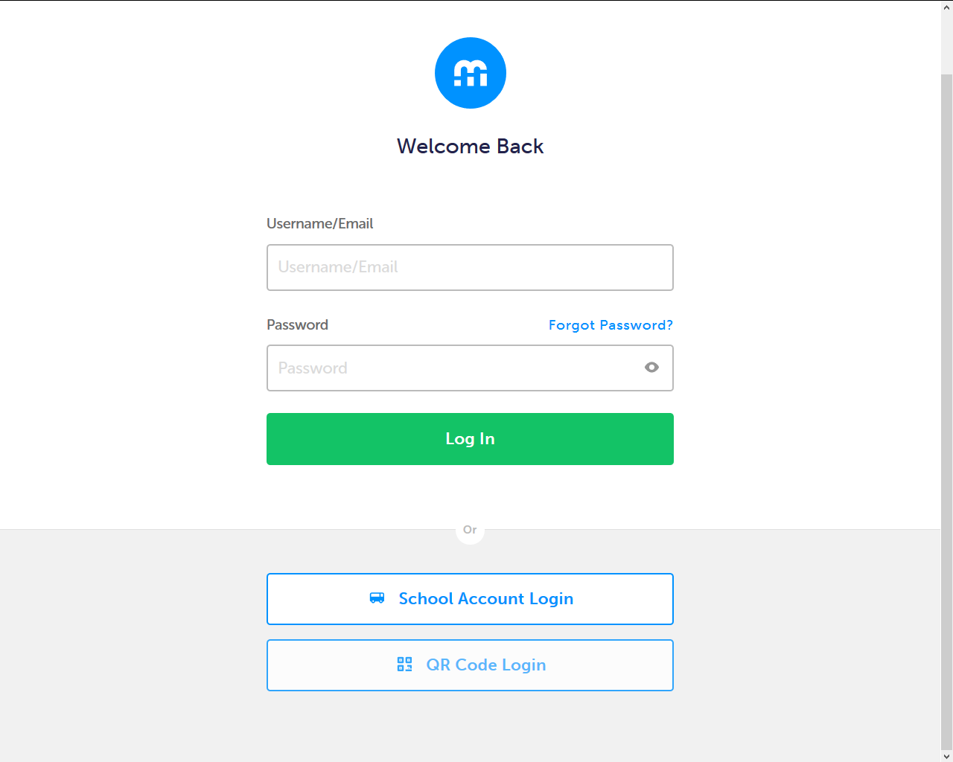
USE MYBLUEPRINT TO UPDATE YOUR IPP TASKS OFTEN!
Click Log In
Then select School Account Login

Slide 10
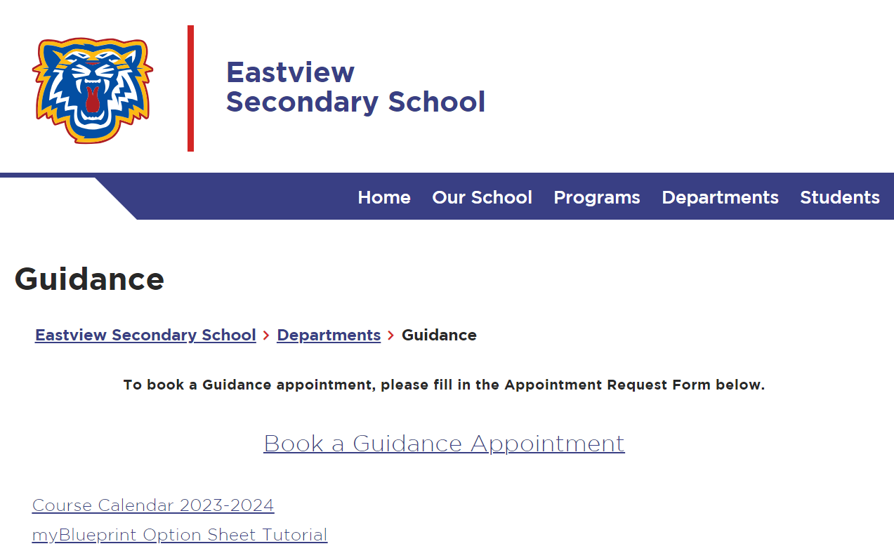
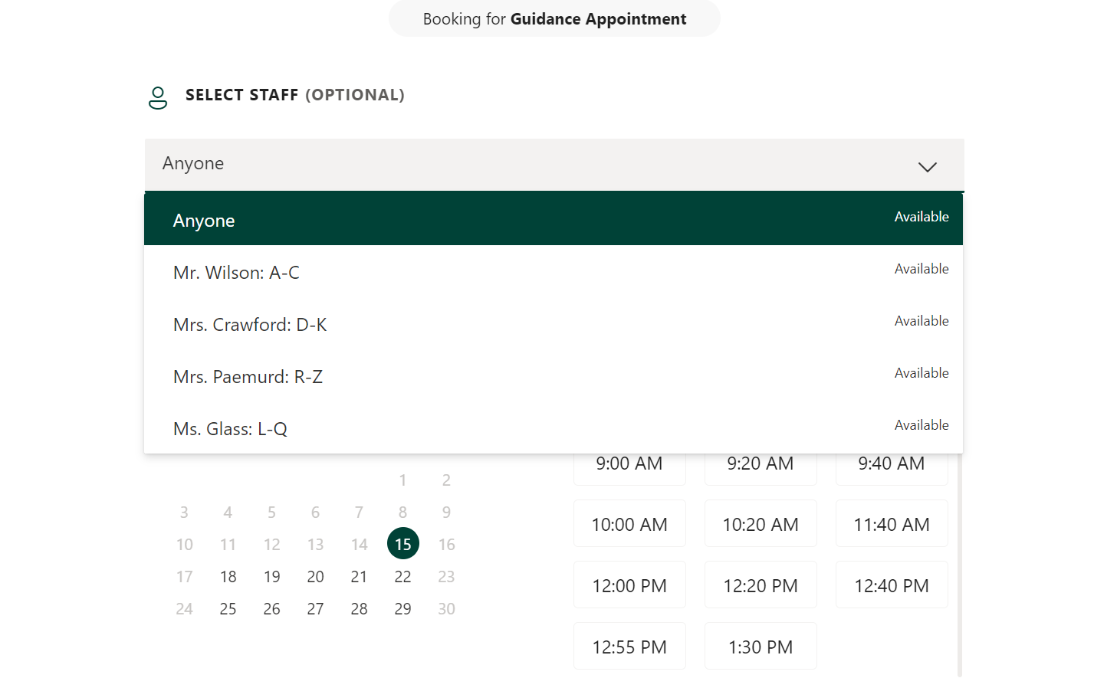
HOW DO YOU MAKE A GUIDANCE APPOINTMENT?
SCAN the QR code in Guidance
OR
Follow the link on the Guidance Page of Eastview’s website!
Be sure to select the correct counsellor based on your surname in the drop-down menu when you book an appointment!

Slide 11
Notes:
Mental Health is a part of our well-being, just as our physical, social, and environmental health are as well.
Just like we take a car in for maintenance, like an oil change, it is just as importance to check up on ourselves to see how our mental health is doing.
With our physical health we are checking in with our bodies. With our mental health, we are not just checking in with our bodies, we are checking in with our thoughts, feelings and behaviors.
And just like physical health, our mental health changes. We go through periods when we don’t feel as mentally well.
OPTIONAL GROUP DISCUSSION: Ask the group to name some of the feelings they’re having about starting high school. -validate feelings (could ask for a show of hands who else feels the same way) -assure students that they can feel many different emotions all at the same time. E.g. you can be excited and anxious at the same time

Slide 12
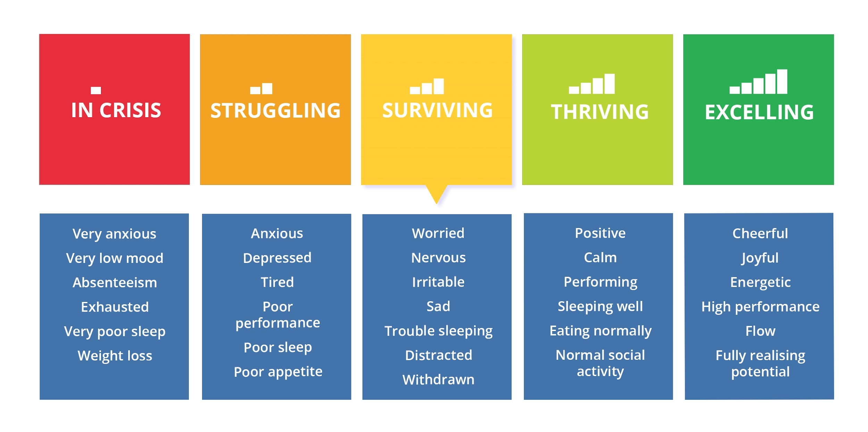
MENTAL HEALTH EXISTS ON A CONTINUUM
Notes:
We all have mental health. It might be helpful to think about mental health as a range or continuum.
On one end is the optimal, on-top-of-the-world mental health. On the other is poor mental health and illness.
On any given day, depending on what we are going through our mental health and coping may change along this continuum.
For example, when we are feeling happy, hanging out with friends, eating well, or are sleeping well, we may be over to the right of the continuum. When you are coping well you may be experiencing things such as completing day to day tasks such as work or homework or feeling an increase in your mood or energy level.
When we are feeling anxious or sad, when a relationship ends or when you noticed an increase of stress due to studying for exams, we may be over to the left of the continuum.
We need to pay attention to our mental health if you experience these types of emotions to the left of the continuum for a longer period of time.
https://delphis.org.uk/mental-health/continuum-mental-health/

Slide 13
WHAT ARE SOME QUESTIONS YOU CAN ASK TO KNOW WHETHER YOU NEED SUPPORT?
Is how I’m thinking, feeling, or acting different for me? A change from how I used to be?
Have I been feeling this way for some time? More than a couple of weeks?
Am I dealing with my problems in unhealthy ways?
Am I simply carrying too much by myself?
Notes:
We all go through times when we don’t feel as mentally well. Changes in feelings and emotions are expected and sometimes they affect how we act. But how do you know when you, or a friend, could use someone’s help to get through a challenge?
Some question to help you decide whether to ask for help.
Is how I’m thinking, feeling, or acting different for me? A change from how I used to be?
Are my thoughts, emotions or actions affecting my everyday life negatively?
Have I been feeling this way for some time, like more than a couple of weeks?
Am I dealing with my problems in unhealthy ways?
Am I carrying too much by myself?
If you or a friend answered mostly yes to these questions, it is probably time to connect with an adult who can help. Reaching out can prevent problems from getting worse.
And if you are still not sure and wondering if you might need help with your mental health, you can always speak to a teacher, guidance counsellor, school social worker, principal or another trusted adult like a parent, coach, relative or family doctor.

Slide 14
CATS - A REMINDER OF OUR STEPS WHEN WE HAVE MENTAL HEALTH CONCERNS ABOUT ANOTHER WILDCAT
C = CONNECT
A = ASK
T = TUNE IN
S = SUPPORT
- check in; see how they’re doing
- if you are worried that there could be a safety concern, ask them a direct question
- use active listening to let them know you are tuned into what they are sharing
- get them to a support person who can help!

Slide 15
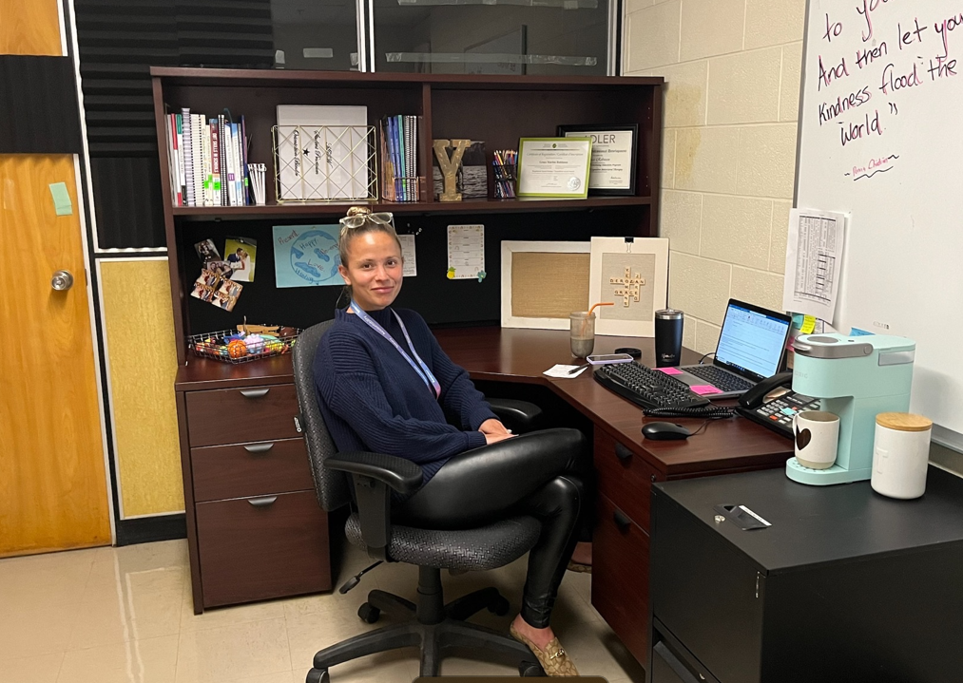
Grace Yeomans:
Social Worker
Provides support and counseling services to students right here at school. Grace supports student success and well-being at school by addressing mental health concerns that interfere with student wellness

Slide 16
ADDITIONAL MENTAL HEALTH SUPPORTS AT EASTVIEW
In addition to Social Work support, Eastview students also have access to a range of mental health supports, including:
1. New Path Youth and Family Services - Adolescent Outreach Counsellor
2. School Mental Health and Addictions - Registered Nurse
3. Canadian Mental Health Association- Social Worker who can provide assistance with accessing community supports

Slide 17
NEED HELP RIGHT NOW?
Call these numbers anytime…
Kids Help Phone
Simcoe County Crisis Line
705-728-5044

Slide 18
OUR EASTVIEW GUIDANCE TEAM
IS HERE FOR YOU!

